Slide 1
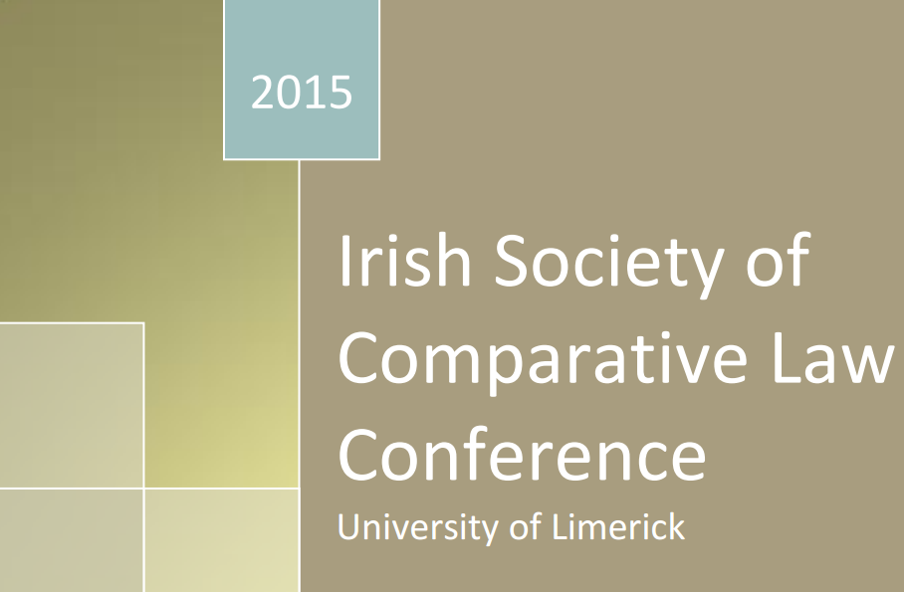
“The Irish Prison System and LGBT Prisoners: A Comparative Approach of Law & Policy in the US, UK & Ireland”
Michael Mullan
06 June 2015

Slide 2
Intro: Comparative analysis

Slide 3
Intro: Outline
Incidence
Unique issues and interests
Policy changes & broader implications

Slide 4
A. Incidence
Unknown
Anecdotal evidence
Connolly v Governor of Wheatfield Prison [2013] IEHC 334

Slide 5
Incidence - Estimate
Ireland LGBT general population (ERSI, 2006):
2.7% - Male
1.2% - Female
LGBT prisoners elsewhere
US: 33% (Gibson & Hensley, 2013)
UK: 3%-5% (Dunn, 2013)
* Approx. 2%-5% *

Slide 6
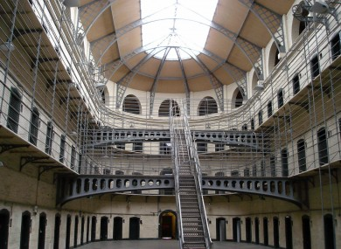
Incidence- Disproportionate? Kunzel (2010) & Richie (2005)
Criminal justice system
Police
Judicial discretion
Heteroflexibility?
Homophobic society?
Mental health
Addiction
Discrimination
Poverty
➔ Crime

Slide 7
B. Unique Concerns
Homophobia
Health
Sex

Slide 8
B. 1. Homophobia
Ireland - Connolly case
Abuse, rape & protection
Northern Ireland- McClenagahn : “Hostile & homophobic environment”
UK- Hansen : “Epidemic”
Green case
Hypermasculinity

Slide 9
B. 2. Health concerns
HIV/Aids
Mental health
Transgender prisoners
Treatment & surgery
Transition
Expression
Housing

Slide 10
C. Sex in prison
Consensual
Safe practice
Staff reaction
Breach of prison Rule 66(1)?
Conjugal visits
Non-consensual
US: 67% & Prison Rape Elimination Act 2003
Lonergan: “prevalent”
O’Donnell: power not sexuality
Assumption of consent
Connolly case

Slide 11
C. Policy recommendations
Prisoner protection –
US: Farmer v Brennan; Johnson v Johnson
LGBT policy - Irish Prison Service
Staff training
Monitoring

Slide 12
Source: Peter Dunn, “Slipping off the equalities agenda? Work with LGBT prisoners” 2013 Prison Service Journal 206, 3, p. 6.

Slide 13
Conclusion
Ill-prepared Irish Prison Service
Harsher punishment?
Comparative studies

Slide 14
“The Irish Prison System and LGBT Prisoners: What can we learn for law & policy from a Comparative Approach”
Michael Mullan
06 June 2015
mmullan@llm16.law.harvard.edu
0876481319

Slide 15
Bibliography – key sources
B. Richie, “Queering anti-prison work African-American lesbians in the juvenile justice system” in Global Lockdown: Race, Gender and the PIC (2005, Taylor and Francis).
Commission for Sex in Prison
Connolly v Governor of Wheatfield Prison [2013] IEHC 334
Farmer v. Brennan
Human Rights Watch, No Escape: Male Rape in United States Prisons (2001)
J. Mogul, A. Ritchie, and K. Whitlock, Queer (In)Justice: Criminalization of LGBT People in the US (2005)
Johnson v. Johnson 385 F.3d 503, 514 (5th Cir. 2004)
L. Gibson & C. Hensley, “The Social Construction of Sexuality in Prison” (2013) 93 Prison J. 355
Make the Road, Police Abuse Of LGBTQ Communities Of Color In Jackson Heights (2012,NY)
M. Deflem, and A. Swygart. “Comparative Criminal Justice” in Handbook of Criminal Justice Administration (2001, Marcel Dekker Publishers).
Mayock and others, Supporting LGBT Lives: A Study Of The Mental Health And Well-Being Of LGBT People, (2009, GLEN and BeLonG To)
P. Ellenbogen, “Beyond the Border: A Comparative Look at Prison Rape in the US and Canada”, (2009) 42 Columbia Journal of Law and Social Problems 336
R. Mann, ” Treatment of Transgender Prisoners - A Comparative Analysis of American, Australian, and Canadian Prison Policies” 15 (2006) Law & Sexuality 91
Regina Kunzel, Criminal intimacy: Prison and the Uneven History of Modern American Sexuality. (2010, University of Chicago Press)
UN Office On Drugs And Crime, Handbook on Prisoners with special needs (2009, UN)

