Slide 1
“‘Tertiary Victimisation’– the Real Life Experiences of Victims with Disabilities in their Interaction with the Criminal Justice System”
Mr Michael Mullan
Saturday 15 February 2014

Slide 2
Introduction
Victimology
Victims with Disabilities
Empirical research – 3 case studies
Tertiary Victimisation
Access to Justice
UN Declaration on the Rights of Persons with Disabilities

Slide 3
A. Commission
High incidence rates
‘Ideal Victimhood’
Vulnerability
Hate crime
Repeat Victimisation

Slide 4
B. Reporting
Underreporting
Fear of institutionalisation
Repercussions
Lack of knowledge
Dependency
Third-party reaction
Actual reporting
Not believed
Lack of information
Lack of accommodations
Physical barriers

Slide 5
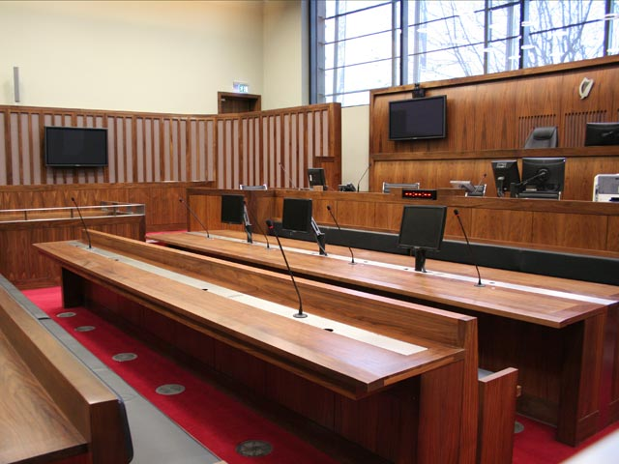
C. Trial Stage
Attrition rates
Decision to go to trial
Criminal Evidence Act 1992
Formality

Slide 6
Tertiary Victimisation
Secondary Victimisation
Reaction by Criminal Justice System

Slide 7
Analysis - Tertiary Victimisation
Mainstream issues
Unique issues
Impact
Recommendations

Slide 8
Conclusion
Intervention
“An individual with a disability is unlikely to achieve justice under the current system”
^{Gordon Ashton J}

Slide 9
Contact Details
Michael Mullan LLB(Bus) Candidate, TCD
mimullan@tcd.ie
087-6481319

